Slide 1
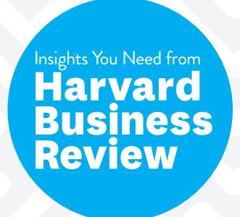
Ch 6: How To Choose Your First AI Project
Ramya Movva
Sujith Siddi
Manas Rahul

Slide 2
Process Deciding in AI
To Become a Master in AI, Plan with one project
Big Data is Important but not the only factor to consider
Google’s Google Brain Project was Google’s First Step

Slide 3
5 Key Points
More Value > Less Risk
Feasible
Industry-Specific Project
Led by Credible Team
Positive Reinforcement for Major Accomplishments

Slide 4
Key POints:
It is expected that AI will create $13 trillion of GDP growth by 2030, according to McKinsey.
Implementing companywide AI is challenging especially for legacy enterprises.
The success of the first AI project will help convince stakeholders to invest in building up the company's AI capabilities.
Choose company-specific project, then your internal stakeholders can understand the value of the project.
Do not build an AI project just that you have more data. Creating an AI system that will create value is more important.

Slide 5
OUr ViewPoint
Ramya – Pretty much agree; Less Risk and confidence is important before you can take more risks- accounting for the tradeoffs in transitioning to your own AI especially
Sujith -
You will find that AI is good at automating tasks rather than jobs
Completely agree with this point as implementing AI for the whole job is very difficult and also may lead to failures. Creating AI systems for tasks that require monotonous work capabilities will create value in a company and also there is less chance of AI overtaking the jobs of humans.

